Slide 1
AI AND MACHINE LEARNING
Hands-on introductory course

Slide 2
Classification

Slide 3
Recap: linear regression
Estimate a continuous output value based on (continuous or categorical) input variables
Example: predict a house’s value given living area, number of bedrooms, building age...
Learn a model based on a large set of training data
For the training data, input variables and output must be known (supervised learning)

Slide 4
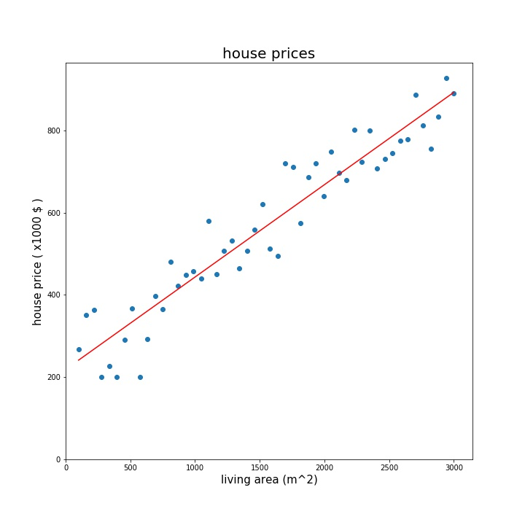
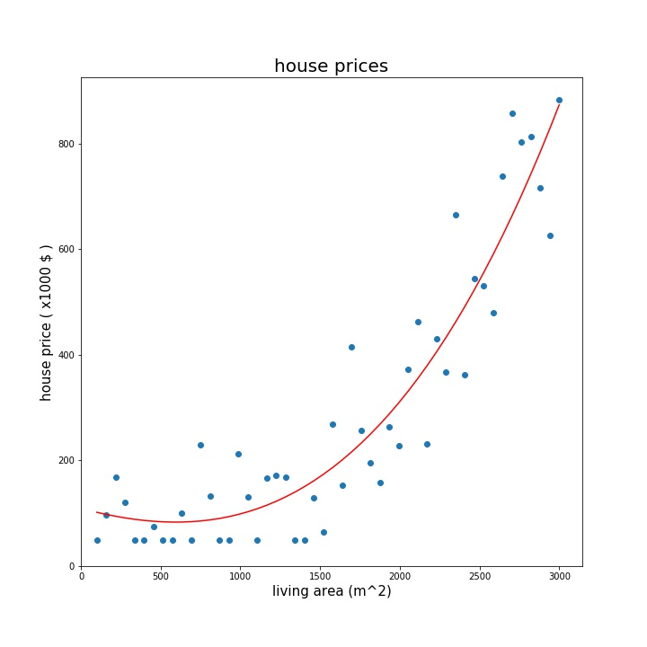
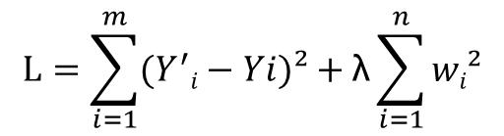
Recap: linear regression
$Y=w0+w1 ∗h1+w1 ∗h2+w3 ∗h3+ …$
$$L=\sum_{i=1}^{m}{(Y^{′}i−Yi)²+\text{λ}\sum_{i=1}^{n}{wi²}}$$
Output is linear function of features
Feature engineering
Overfit/underfit
Regularization
Hyperparameter tuning
Cross-validation

Slide 5
Classification (supervised)
Classify a datapoint into one of the possible categories, based on the features of the datapoint
Example: iris dataset
Supervised learning: input variables and labelled target output must be known in advance

Slide 6



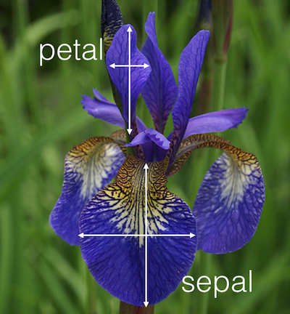
Classification example: iris dataset
Iris setosa
Iris versicolor
Iris virginica

Slide 7
Classification example: iris dataset
150 samples (3 x 50)
3 classes
setosa
versicolor
virginica
4 features (without feature engineering)
sepal length
sepal width
petal length
petal width
Features |  |  |  | Target
Sepal length | Sepal width | Petal length | Petal width | species
5,1 | 3,5 | 1,4 | 0,2 | Setosa
7,0 | 3,2 | 4,7 | 1,4 | Versicolor
6,0 | 3,0 | 4,8 | 1,8 | Virginica
4,9 | 3,0 | 1,4 | 0,2 | Setosa
... | ... | ... | ... | ...
Notes:
classic example

Slide 8
Classification
Classify a datapoint into one of the possible categories, based on the features of the datapoint
Example: iris dataset
Learn a model based on a large set of training data
Training data must be labelled

Slide 9
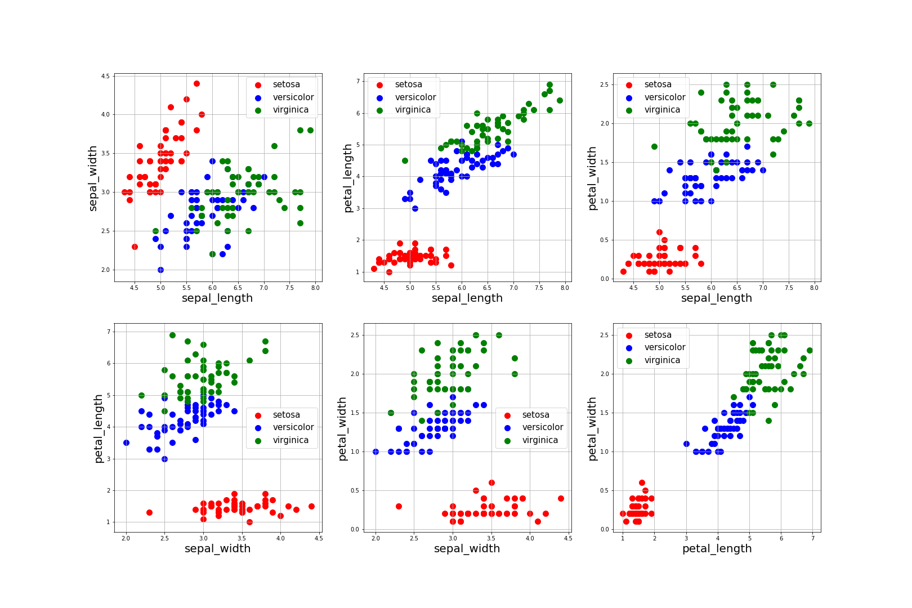
Notes:
logistic regression is most important type of linear classification

Slide 10
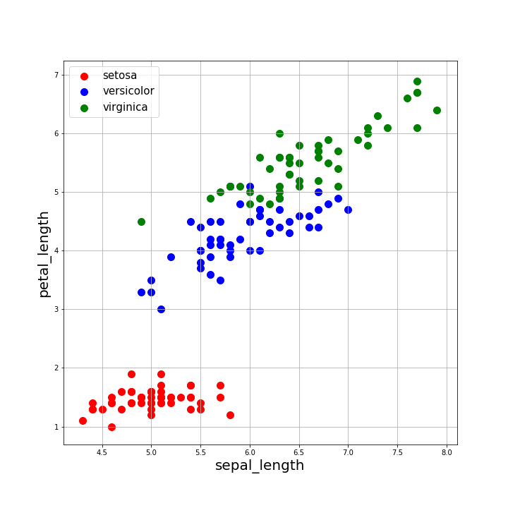
Linear classification: logistic regression
GOAL:
Based on labeled training set, learn a decision boundary
Decision boundary will be linear in features
VIRGINICA
VERSICOLOR
SETOSA
Notes:
example for 2D (2 input variables). In reality, there are 4 input variables, but I cannot make a 4D plot
boundary is linear in features. We would be able to draw non-straight lines in this plot, if we would do manual feature engineering
in logistic regression, NON-LINEAR BOUNDARY requires MANUAL FEATURE ENGINEERING

Slide 11
Binary classification
Only 2 output classes
Y = 0
Y = 1
Any number of features
For example, if our dataset contained only 2 types
Y = 0 → setosa
Y = 1 → versicolor

Slide 12
Binary classification
Similar to linear regression...
...But with a binary output?
Idea: “force” output between 0 and 1
If result closer to 1, predict 1
If result closer to 0, predict 0
$Y=w0+w1 ∗h1+w1 ∗h2+w3 ∗h3+ …+wn ∗hn$
$Z=w0+w1 ∗h1+w1 ∗h2+w3 ∗h3+ …+wn ∗hn$
Notes:
similar to linear regresion...
...but our output must be binary. Not a continuous value, but 0 or 1

Slide 13
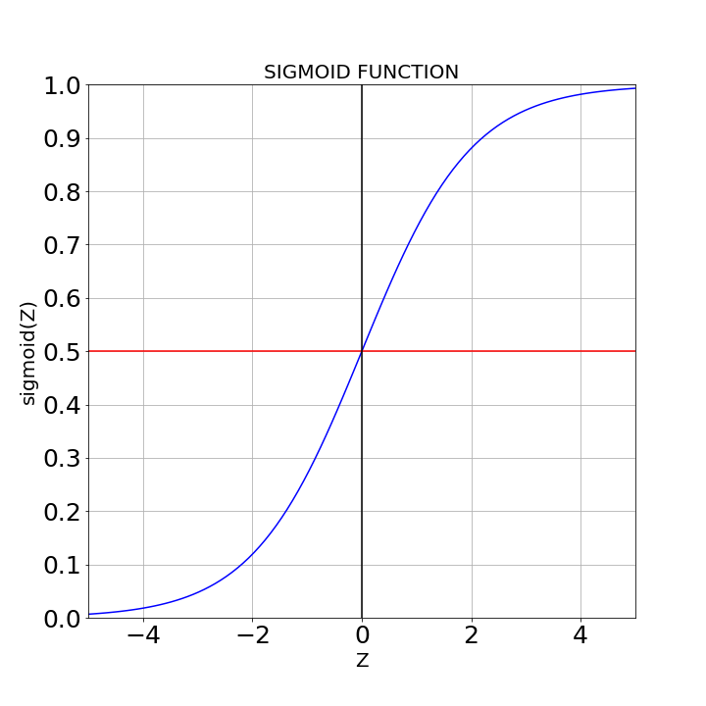
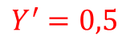
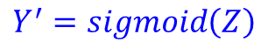
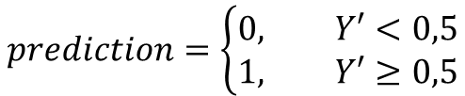
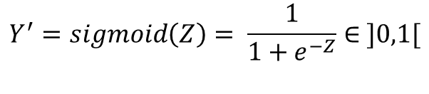
The sigmoid activation function
$Z=w0+w1 ∗h1+ …+wn ∗hn$
$$Y^{′}=sigmoid\left(Z\right)$$
$$Y^{′}=sigmoid\left(Z\right)= \frac{1}{1+e^{−Z}}∈ ]0,1[$$
$$Y^{′}=0,5$$
$$prediction=\left\{\begin{aligned}0, Y′<0,5 \\ &1, Y′≥0,5\end{aligned}\right.$$
Interpret Y’ as a probability: Y’ = P(Y’=1)
Y’ = 0,68 → prediction = 1 with 68% probability
P(Y’=1) = probability of class 1 = 68%
P(Y’=0) = probability of class 0 = 32%
Predict 0
Predict 1
Notes:
reflect on meaning of “probability”. Is this a probability in strict mathematical sense?
note: Y’ = 0,5 for Z : 0
Z negative → Y < 0,5 and vice versa
note about notation: Y’=P(Y’=1) is the probability that output is 1. The notation is tricky, because maybe the probability that output is 1 is better written as P(Y=1), but then we have problems
in the notation and derivation of the likelihood. Be careful!

Slide 14
Binary classification
Predictions → Y’ ∈ ]0,1[
Training data: Y = 0 or Y = 1
Learning the weights w_{i}?
$Z=w0+w1 ∗h1+ …+wn ∗hn$
$$Y^{′}=sigmoid\left(Z\right)= \frac{1}{1+e^{−Z}}∈ ]0,1[$$
$$prediction=\left\{\begin{aligned}0, Y′<0,5 \\ &1, Y′≥0,5\end{aligned}\right.$$

Slide 15
Linear-decision boundaries only
$Z=w0+w1 ∗h1+ …+wn ∗hn$
Logistic regression can only detect linear boundaries in the features
VIRGINICA
$$Y^{′}=sigmoid\left(Z\right)= \frac{1}{1+e^{−Z}}∈ ]0,1[$$
$$prediction=\left\{\begin{aligned}0, Y′<0,5 \\ &1, Y′≥0,5\end{aligned}\right.$$
VERSICOLOR
SETOSA

Slide 16
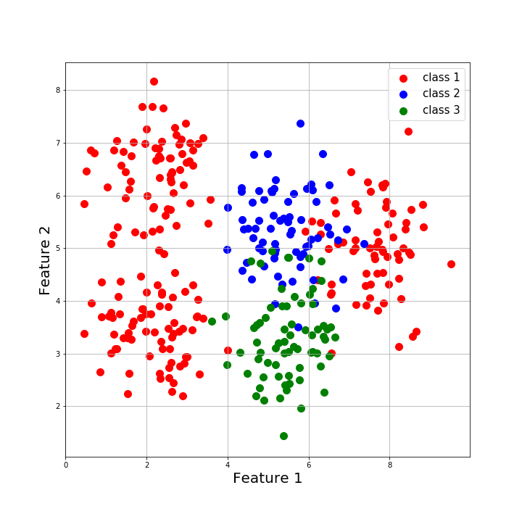
Linear-decision boundaries only
$Z=w0+w1 ∗h1+ …+wn ∗hn$
Logistic regression can not detect non-linear boundaries in the features
$$Y^{′}=sigmoid\left(Z\right)= \frac{1}{1+e^{−Z}}∈ ]0,1[$$
$$prediction=\left\{\begin{aligned}0, Y′<0,5 \\ &1, Y′≥0,5\end{aligned}\right.$$
?

Slide 17
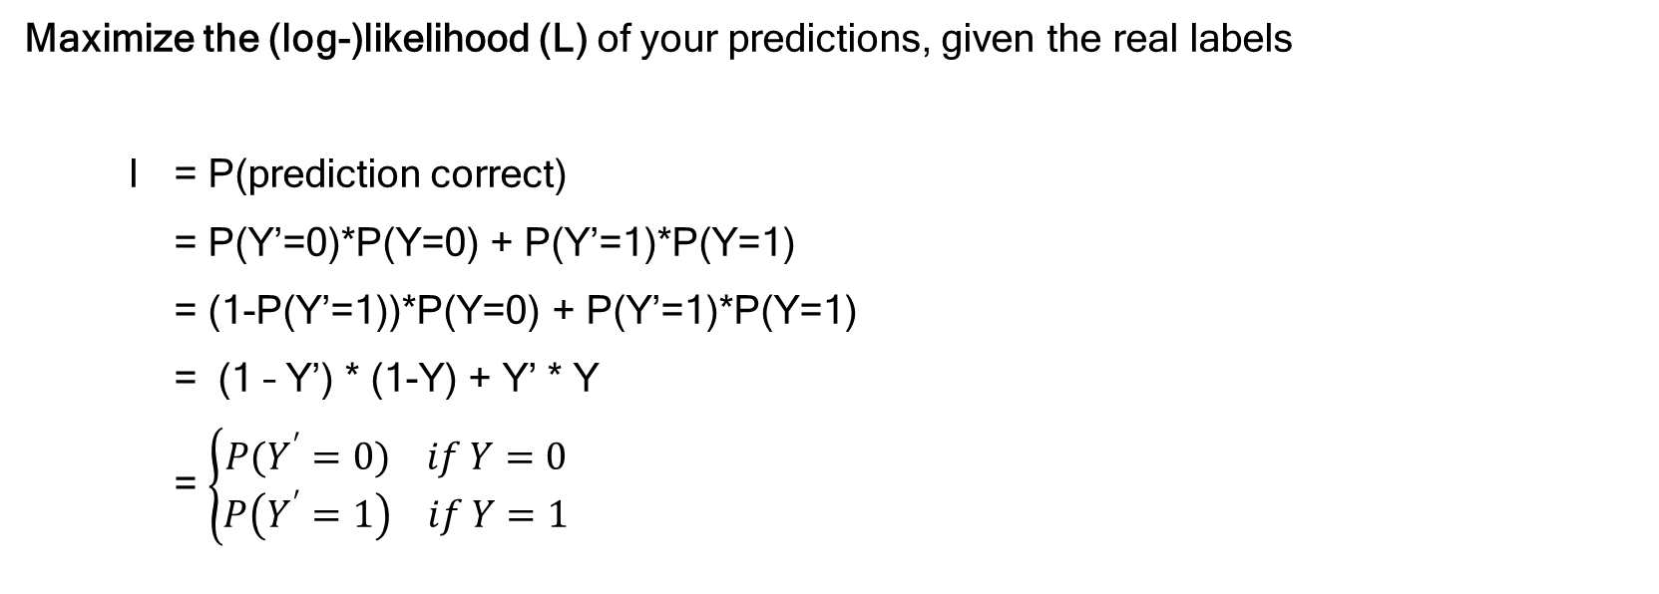
Learning the weights
Maximize the (log-)likelihood (L) of your predictions, given the real labels
l = P(prediction correct)
= P(Y’=0)*P(Y=0) + P(Y’=1)*P(Y=1)
= (1-P(Y’=1))*P(Y=0) + P(Y’=1)*P(Y=1)
= (1 – Y’) * (1-Y) + Y’ * Y
= $\left\{\begin{aligned}P(Y^{′}=0) if Y=0 \\ P\left(Y^{′}=1\right) if Y=1\end{aligned}\right.$
Notes:
“OR” = summing probabilities
no matter the maths, in the end example will be very intuitive as to what we are optimizing.

Slide 18
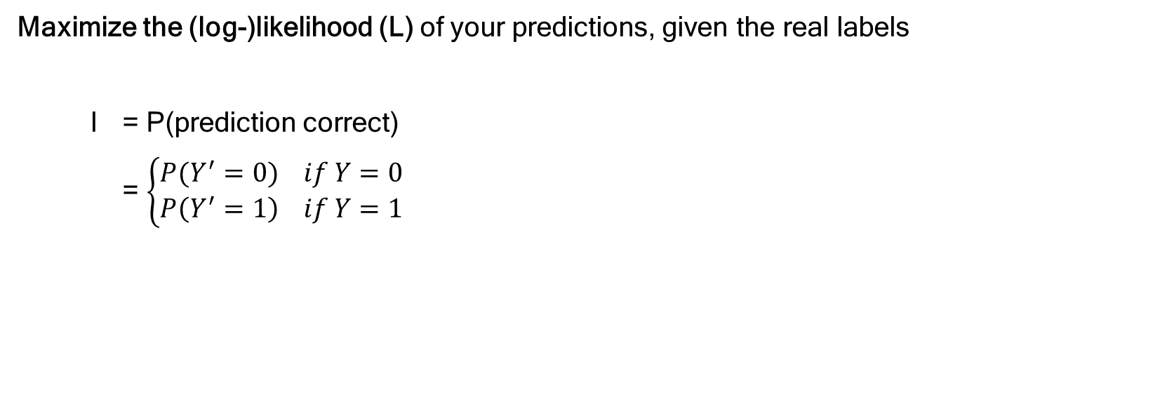
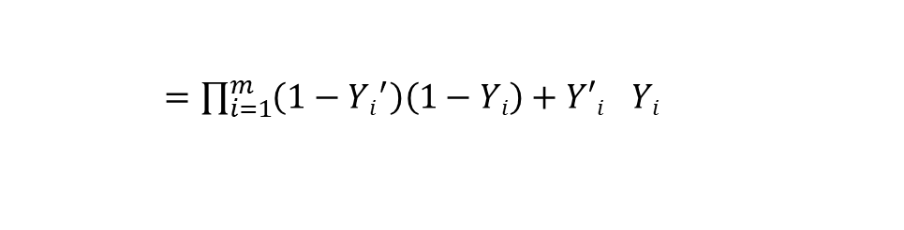
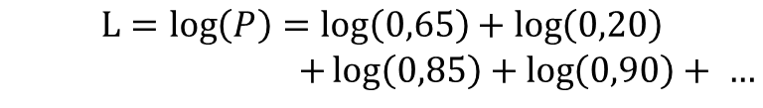
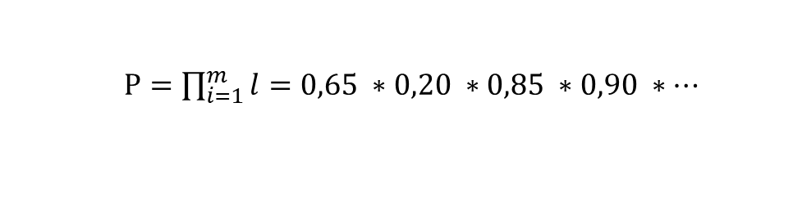
Learning the weights
Maximize the (log-)likelihood (L) of your predictions, given the real labels
l = P(prediction correct)
= $\left\{\begin{aligned}P(Y^{′}=0) if Y=0 \\ P\left(Y^{′}=1\right) if Y=1\end{aligned}\right.$
likelihood
Y | Y’ | correct? | P(Y’=0) | P(Y’=1) | l
0 | 0,35 | yes | 0,65 | 0,35 | 0,65
1 | 0,20 | no | 0,80 | 0,20 | 0,20
1 | 0,85 | yes | 0,15 | 0,85 | 0,85
0 | 0,10 | yes | 0,90 | 0,10 | 0,90
... | ... | ... | ... | ... | ...
$P=\prod_{i=1}^{m}{l=0,65 ∗0,20 ∗0,85 ∗0,90 ∗…}$
$=\prod_{i=1}^{m}{\left(1−{Yi}^{′}\right)\left(1−Yi\right)+{Y′i}^{}Yi }$
log-likelihood
$$L=\log\left(P\right)=\log\left(0,65\right)+\log\left(0,20\right)$$
$+\log\left(0,85\right)+\log\left(0,90\right)+ …$
Maximize L
Notes:
classic example
“OR” = summing probabilities
note: if correct = ‘no’, likelihood is low.
independent probabilities → multiply
logarithm is monotonically rising function, so maximizing likelihood is maximizing loglikelihood!
note: product of many probabilities is very small. L will be negative (log(x) < 0 if x<1), maximize L means “least negative”

Slide 19
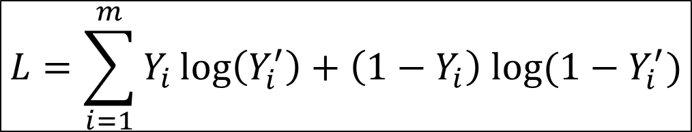
Gradient ascent
$$L=\sum_{i=1}^{m}{Y_{i}\log\left(Y_{i}^{′}\right)+\left(1−Y_{i}\right) log⁡(1−Y_{i}^{′})}$$
Likelihood is a function of the weights
Maximize likelihood
Gradient ascent (In practice, stochastic gradient ascent)

Slide 20
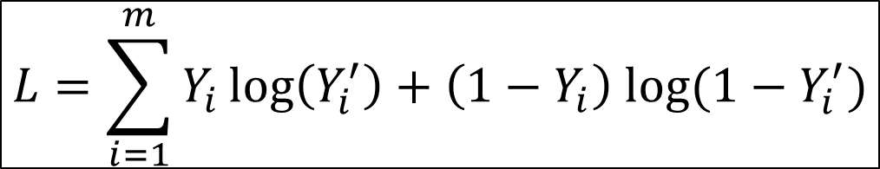
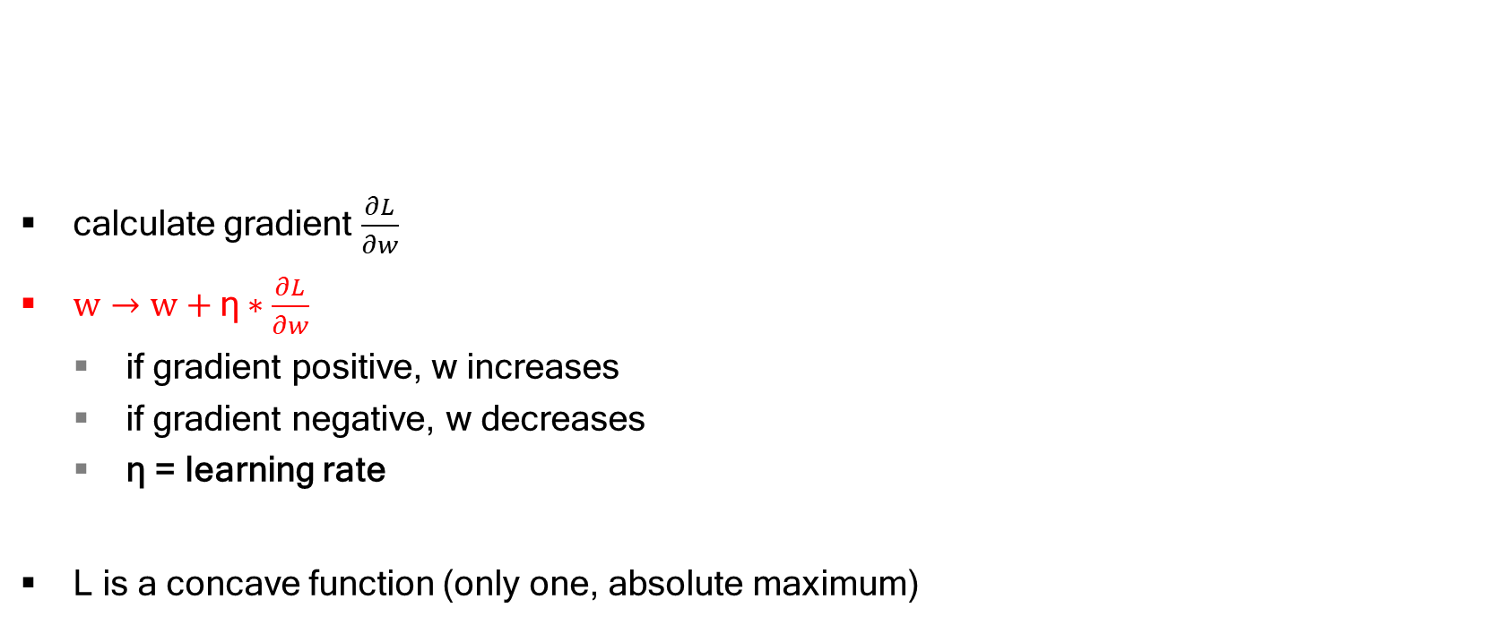
Gradient ascent
$$L=\sum_{i=1}^{m}{Y_{i}\log\left(Y_{i}^{′}\right)+\left(1−Y_{i}\right) log⁡(1−Y_{i}^{′})}$$
calculate gradient $\frac{∂L}{∂w}$
$w→w\text{ + }\text{η}∗\frac{∂L}{∂w}$
if gradient positive, w increases
if gradient negative, w decreases
$\text{η}$ = learning rate
L is a concave function (only one, absolute maximum)

Slide 21
Multiclass classification with logistic regression
One-versus-all
Train multiple binary classifiers, one for each class (is it class X or not)
Predict: run each binary classifier, pick class with highest probability
Y’₁=0,35
Y’₂=0,25 → predict class 2
Y’₃=0,45
Softmax regression (example: 3 classes)
Use multiple outputs Z₁,Z₂,Z₃
Predict class corresponding with highest value
Convert to probabilities with softmax activation function
Out of current scope, see neural networks
Notes:
note that indices now point to different CLASSES (not samples!)
one-versus-all: note that in example, all probabilities are below 0,5, but still one must be chosen (it can’t be “NONE OF THESE”)
softmax regression:
OUT OF CURRENT SCOPE
softmax not very difficult, but we come back to it later for neural networks. There, we also use softmax activation as the last step. However, the algorithm itself is completely different except for this last step

Slide 22
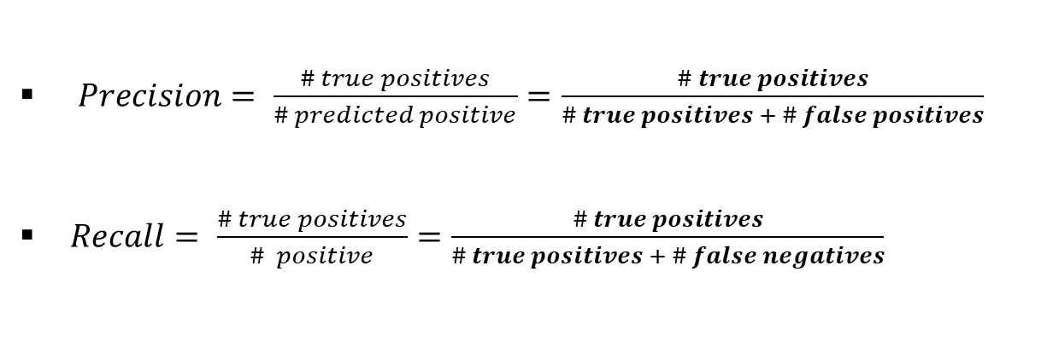
Performance metrics: precision and recall
Accuracy is a bad metric (example: majority classifier)
Precision = fraction of positive predictions that are actually positive
Recall = fraction of positive data predicted to be positive
 | Y’ = 0 | Y’ = 1
Y = 0 | true negative | false negative
Y = 1 | false negative | true positive
$Precision= \frac{\# true positives}{\# predicted positive}=\frac{\# true positives}{\# true positives + \# false positives}$
$Recall= \frac{\# true positives}{\# positive}=\frac{\# true positives}{\# true positives + \# false negatives}$
Notes:
precision: positive predictions are actually positive (import for example review sentiment classifier, if website wants to hide negative reviews)
recall: important if website owner wants to respond to negative reviews (“positive” means “bad review” here), don’t miss out on to many bad reviews!
precision and recall are for multiclass as well. Calculate this for every class

Slide 23
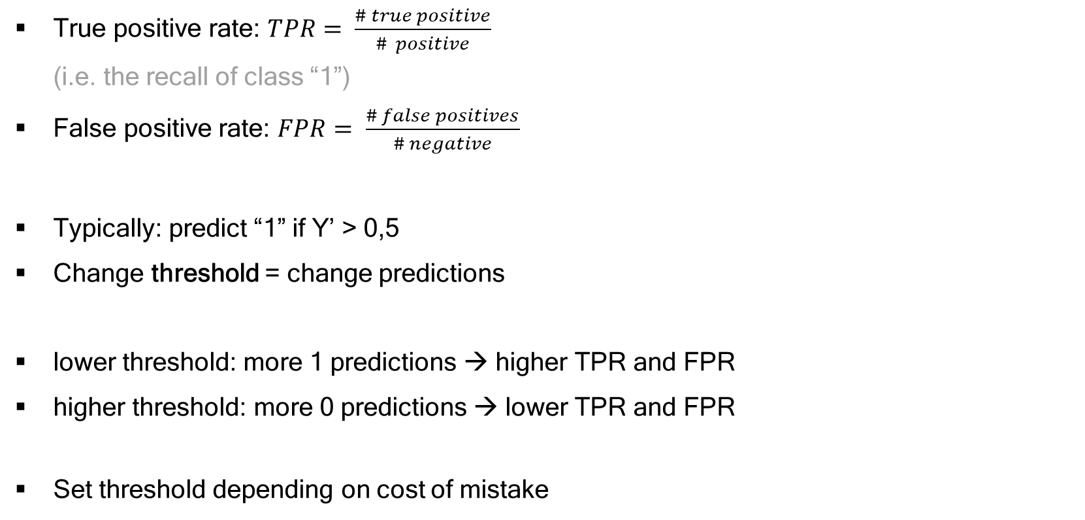
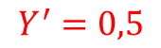
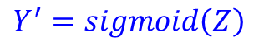
Performance metric: ROC curve (binary classification)
True positive rate: $TPR= \frac{\# true positive}{\# positive}$
(i.e. the recall of class “1”)
False positive rate: $FPR= \frac{\# false positives}{\# negative}$
Typically: predict “1” if Y’ > 0,5
Change threshold = change predictions
lower threshold: more 1 predictions → higher TPR and FPR
higher threshold: more 0 predictions → lower TPR and FPR
Set threshold depending on cost of mistake
$$Y^{′}=sigmoid\left(Z\right)$$
$$Y^{′}=0,5$$
Notes:
TPR is recall in binary classification

Slide 24
Performance metric: ROC curve (binary classification)
A terrible model: random predictions (Y’ is random)
baseline
for any threshold, FPR = TPR
the probability of labelling a “0” as a “1” is equal to the
probability of labelling a “1” as a “1”
A good model
is better than the baseline
has high TPR and low FPR (at least TPR > FPR)

Slide 25
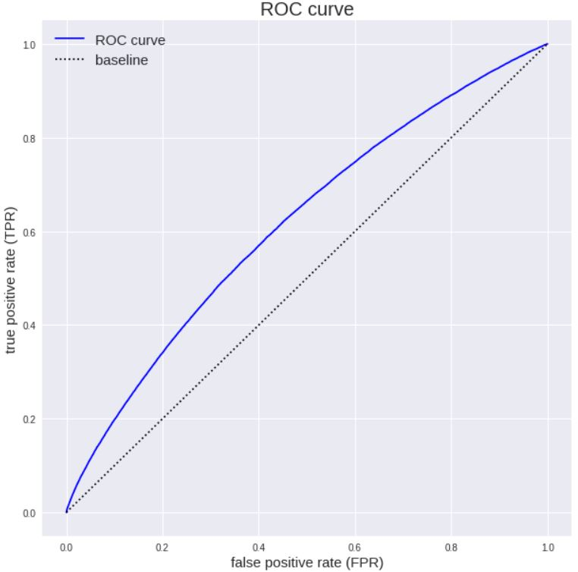
Performance metric: ROC curve (binary classification)
ROC = Receiver Operating
Characteristic
Good model = large Area
Under the Curve (AUC)

Slide 26
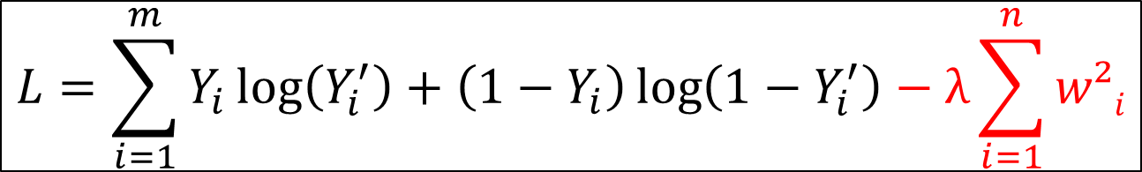
Regularization
L1 and L2 regularization (just like in linear regression)
Penalize large weights, reduce variance
Adding a term to L → gradient acent
e.g. L2-regularization
$$L=\sum_{i=1}^{m}{Y_{i}\log\left(Y_{i}^{′}\right)+\left(1−Y_{i}\right)\log\left(1−Y_{i}^{′}\right)−\text{λ}\sum_{i=1}^{n}{w²i}}$$

Slide 27
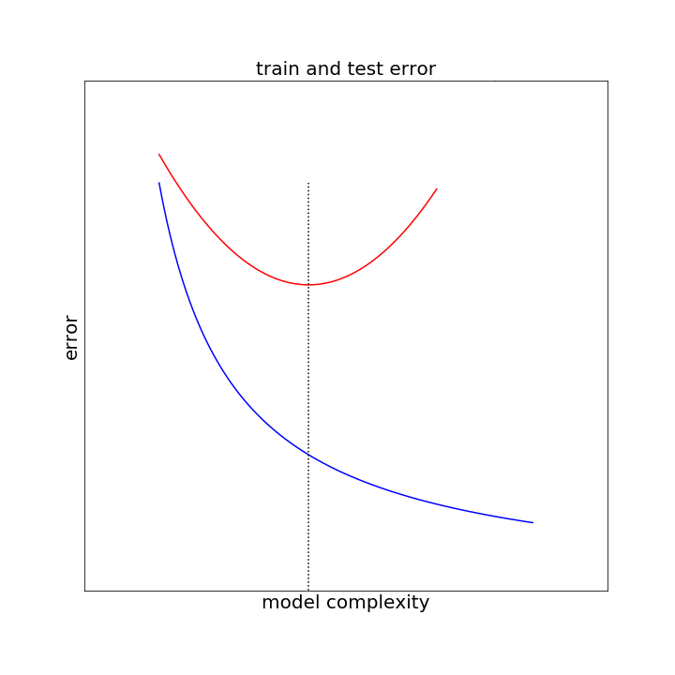
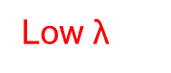

sweet spot
High $\text{λ}$
Low $\text{λ}$
Notes:
Again, hyperparameter optimization for lambda
cross-validation etc

